Slide 1
MDS 535 Programming language and environments: Scala Programming on the apache Spark platform
David A. Ostrowski

Slide 2


Overview
Spark Stack Overview
Spark / Scala Introduction
Scala Basics
RDD operations
Spark SQL
Standalone applications with Scala
Streaming Spark
MLIB
GraphX

Slide 3
Spark
Another engine for large-scale processing
Implemented in Scala
Support for Scala, Java ,Python
Documented speed is an order of magnitude faster than pig, hive (10-20X)

Slide 4
Spark (cont.)
General purpose
Allows for interactive queries / programming as well as stream processing
Tight integration bet. Core and libraries
Core more strongly supports SQL and ML programs speed up as well
Cleaner than alternatives : pure Java, PIG with UDFs, etc.

Slide 5
Spark (cont.)
Spark does NOT require Hadoop!
It provides support for storage systems implementing the Hadoop APIs
Includes local file system, Amazon S3, Cassandra, Hive, Hbase
Spark supports text files, SequenceFiles, Avro, Parquet and any other hadoop InputFormat

Slide 6
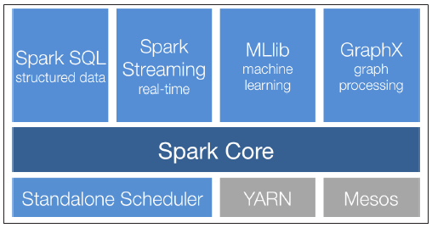
Spark Stack

Slide 7
Spark Overview Spark Core
Basic Functionality of Spark
Task scheduling
Memory Management
Fault recovery
Interaction with Storage Systems
Resilient Distributed Datasets (RDD) API
Spark’s main programming paradigm
RDDs represent a collection of items distributed across many compute nodes that can be manipulated in parallel

Slide 8
Spark Libraries Spark SQL (Formerly Shark)
Spark’s package for working with structured and unstructured data
Provides three main capabilities:
It can load data from a variety of structured sources (e.g. JSON, Hive and Parquet)
Rich integration between SQL and regular Python/ Java/ Scala code, including the capability to join RDDs and SQL tables, expose custom functions
Also allows one to query the data using SQL from external tools through standard database connections (JDBC/ ODBC) including Tableau
Also easy to use!

Slide 9
Spark Libraries Spark Streaming
A Spark component that enables processing live streams of data
Not to be confused with Hadoop-based Streaming I/O
This technology enabled others to stream in data to any program with standard I/O based stream
This is designed specifically among the spark based languages to manage real-time streams of data (large collections)
While fun to use – you do not have as much of a need in the Spark environment as you already have the power of three different Turing-Complete languages to choose from and SQL !
Examples:
Core’s RDD API makes it easy for programmers to learn the project and move between applications that manipulate data stored in memory, on disk or arriving in real time

Slide 10
Spark Libraries MLIB
MLIB provides multiple types of machine learning algorithms
All are scalable across a cluster
A set of functions called directly in Scala that can be applied to a data collection
Allowing for you to call various functions on Distributed data sets and provide for immediate comparison
Completely integrated as a library to be imported in your code (easy to use)

Slide 11
Spark Libraries GraphX
A library that provides an API for manipulating graphs and performing graph-parallel computations
GraphX extends Sparks RDD API , allowing one to create a directed graph with arbitrary properties.
Same as MLIB, called directly as functions which allow for the means of supporting graph representation as well as operations

Slide 12
What is Scala – why do we want it?
Scala is a language that has gained traction lately (even before Spark) due to
Strongly typed
JVM Language
All code is converted to bytecode
Platform independence of Java
Can leverage Java API
Perhaps reach the potential of Jython
Support ‘Scaling up’ due to being strongly typed and high support for functional programming
Spark is written in 20,000 lines of Scala

Slide 13
What is Scala – More Reasons
Highly Object Oriented
Between Java and SmallTalk / Squeak
Very Condense (no code bloat associated with Java)
Expressive
First Class functions
Concise
Type Inference
Literal Syntax for function creation

Slide 14
What is Scala – More Reasons
Java interoperability
Can reuse java libraries
Can reuse java tools
No performance penalty

Slide 15
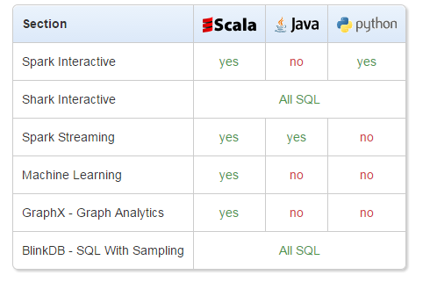
What is Scala – More Reasons

Slide 16
Why Scala
Functional / Parallel
Best support
Concise
Interpretive Prompt

Slide 17
Running Scala through Spark interpretive prompt
All examples in Scala/Spark are managed in the interpretive prompt
To start the spark interactive prompt type “spark-shell” within the bin directory
After logging on – change directory to the spark home directory:
ubuntu@ip-172-31-21-139:~$ cd spark-1.2.0-bin-hadoop1
From the home directory run the startup shell script as follows:
/spark-1.2.0-bin-hadoop1$ ./bin/spark-shell
You can then cut/paste the code directly into the “spark” interpretive prompt

Slide 18
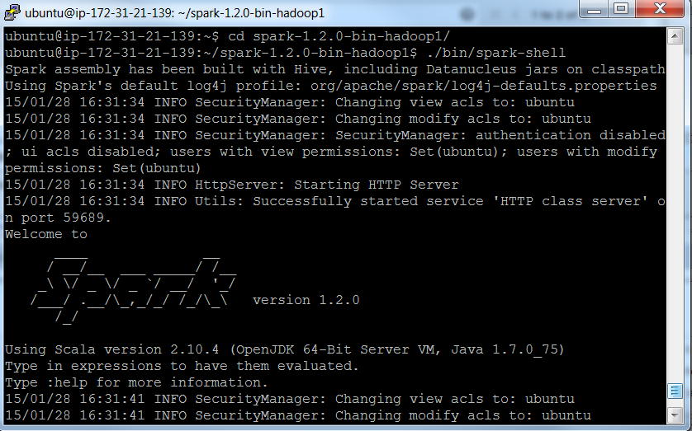
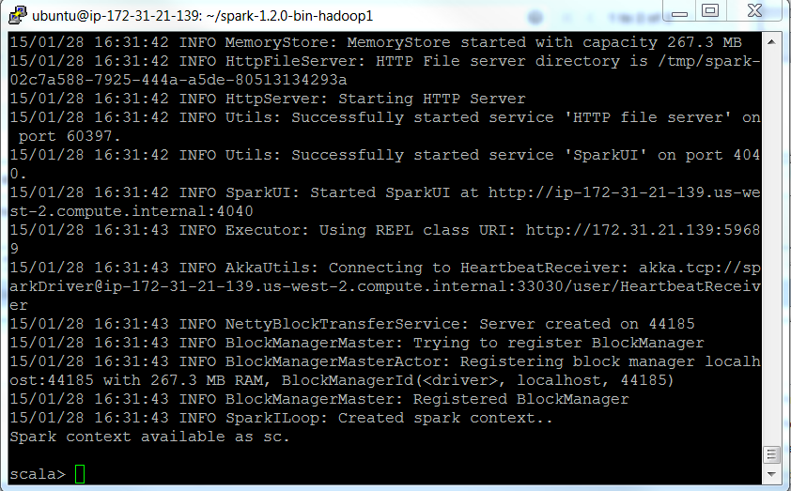
Running Scala through Spark interpretive prompt
All examples in Scala/Spark are managed in the interpretive prompt
Again, present the screen as to what exactly the spark prompt will look like………

Slide 19
Scala (typed directly into the Spark/Scala Shell)
//Default variables are assigned to any expressions
scala>8 * 5 + 2
Res0: Int = 42
Scala>0.5 * res0
Res1= Double = 21.0
//All simple data types are objects
scala>”Hello, “ + res0
Res2: java.lang.String = Hello, 42
scala>10.toString()
Res2: String = 10

Slide 20
Scala (typed directly into the Spark Shell)
scala>a.+(b)
Res1: Int = 200 //So you can consider , the operator as a method
A method b as a shorthand for a.method(b)
scala>val myVal: String = “Foo”
keyword “val” this means that a variable cannot change value (immutable variable)
scala>var myVar:String = “Foo”
the keyword var means that it is a variable that can be changed (mutable variable)

Slide 21
Scala
When you assign an initial value to a variable , the Scala compiler can figure out the type of the variable based on the value assigned to it (variable type inference)
myVal = "test" // gave an error
myVar = "test" // can change
If stmt
scala>val x = 20;;
scala>If (x < 21){
scala> - println(“x is less than 21”);
scala> - }else{
scala> printlin(‘ x is greater than or equal to 21’);
scala>}

Slide 22
Scala
scala> val myNumbers = List(1,2,3,4,5,4,3)
myNumbers: List[Int] = List(1, 2, 3, 4, 5, 4, 3)
NOTE: The “<-” implies iteration through a collection – like I python saying for item in list:
scala> for (num <- myNumbers)
| println(num)
1
2
…
scala> for (i <- 1 to 10)println(i)
1
2
3
…

Slide 23
Scala
scala> var count = 0
count: Int = 0
scala> do {
| count += 1
| println(count)
| } while(count < 10)
1
2
.
.
10

Slide 24
Scala functions: background
With Java, C++ etc. you are programming in an imperative style (you give one imperative command at a time, iterate with loops and mutate state shared between different functions)
Scala allows you to program imperatively as well as in a more functional style.
In Scala, functions are first-class constructs, this is evidenced by the following application of a function passed as an argument

Slide 25
Scala functions: background
One concise means of printing a list
scala> var myVar = List(1,2,3)
myVar: List[Int] = List(1, 2, 3)
scala> myVar.foreach((arg: Int) => println(arg))
1
2
3

Slide 26
Scala functions: background
One concise means of printing a list
scala> var myVar = List(1,2,3)
myVar: List[Int] = List(1, 2, 3)
scala> myVar.foreach((arg: Int) => println(arg))
scala>List(1,2,3).foreach((arg: Int) => println(arg))
scala>List(1,2,3).foreach(println)

Slide 27
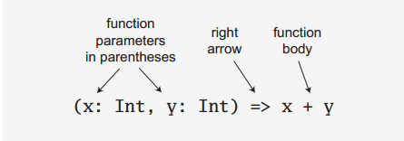
Scala functions: background
The prior examples demonstrate a ‘function literal’ using the ‘=>’ reserved word (simply referenced as a ‘right arrow’)
Here is a breakdown of the function literal syntax:

Slide 28
Scala functions: background
In an effort to guide you into a functional direction a functional relative of the imperative ‘for’ is available in Scala
scala> for (arg <- List(1,2,3))
| println(arg)
1
2
3
Here, the ‘<-’ operator is interpreted as ‘in’ just as for (arg in List(1,2,3)

Slide 29
Scala functions
scala> def cube(a: Int): Int = a * a * a
cube: (a: Int)Int
scala> myNumbers.map(x => cube(x))
res8: List[Int] = List(1, 8, 27, 64, 125, 64, 27)
scala> myNumbers.map(x => x * x * x)
res9: List[Int] = List(1, 8, 27, 64, 125, 64, 27)

Slide 30
Scala functions
scala> val myNumbers = List(1,2,3,4,5,4,3)
myNumbers: List[Int] = List(1, 2, 3, 4, 5, 4, 3)
scala> def factorial(n:Int):Int = if (n==0) 1 else n * factorial(n-1)
factorial: (n: Int)Int
scala> myNumbers.map(factorial)
res18: List[Int] = List(1, 2, 6, 24, 120, 24, 6)
scala> myNumbers.map(factorial).sum
res19: Int = 183

Slide 31
Scala
scala> var factor = 3
factor: Int = 3
scala> val multiplier = (i:Int) => i * factor
multiplier: Int => Int = <function1>
scala> val l1 = List(1,2,3,4,5) map multiplier
l1: List[Int] = List(3, 6, 9, 12, 15)
scala> factor = 5
factor: Int = 5

Slide 32
Scala functional programming
Take note that _ * 2 is a function literal that is shorthand for i=>i *2. For each argument to the function, you can use _ if the argument is used once
scala> List(1,2,3,4,5) map { _ * 2}
res14: List[Int] = List(2, 4, 6, 8, 10)

Slide 33
Scala functional programming
The first _ represents the argument that is accumulating the value of the reduction and the second _ represents the current value of the list (this will multiply all numbers in a list)
scala> List(1,2,3,4,5) reduceLeft { _ * _ }
res15: Int = 120
NOTE: the code above will iterate through the list and multiply each item in the list with each other
for item in list:
total = total * item

Slide 34
Scala Simple Classes
scala> class Person{
private var privateAge= 0
def age = privateAge
def age_=(newValue: Int){
if (newValue > privateAge) privateAge = newValue;
}
}
scala>val fred = new Person
scala>fred.age =30
scala>fred.age = 21
scala>println(fred.age)

